Slide 1
iFour Consultancy
HTML (Hyper Text Markup Language)
Notes:
Software Outsourcing Company India - http://www.ifourtechnolab.com/

Slide 2
Introduction To HTML
A markup language is a set of markup tags
A markup language is a set of markup tags
What Is HTML?
Markup language for describing web pages
HTML stands for Hyper Text Markup Language, a language with set of markup tags
Documents are described by HTML tags
Each HTML tag describes different document content
Notes:
Software Outsourcing Company India - http://www.ifourtechnolab.com/

Slide 3
Creating HTML Pages
An HTML file must have an .htm or .html file extension
HTML files can be created with text editors:
NotePad, NotePad ++, PSPad, Visual Studio
Notes:
Software Outsourcing Company India - http://www.ifourtechnolab.com/

Slide 4
HTML Structure
HTML is comprised of “elements” and “tags”
Begins with <html> and ends with </html>
Elements (tags) are nested one inside another:
Tags have attributes:
HTML describes structure using two main sections: <head> and <body>
<html> <head></head> <body></body> </html>
<img src="logo.jpg" alt="logo" />
Notes:
Software Outsourcing Company India - http://www.ifourtechnolab.com/

Slide 5
HTML Code Formatting
The HTML source code should be formatted to increase readability and facilitate debugging
Every block element should start on a new line
Every nested (block) element should be indented
Browsers ignore multiple whitespaces in the page source, so formatting is harmless
For performance reasons, formatting can be sacrificed
Notes:
Software Outsourcing Company India - http://www.ifourtechnolab.com/

Slide 6
First HTML Page
Test.html
<!DOCTYPE HTML>
<html>
<head>
<title>My First HTML Page</title>
</head>
<body>
<p>This is some text...</p>
</body>
</html>
Notes:
Software Outsourcing Company India - http://www.ifourtechnolab.com/

Slide 7
First HTML Page: Tags
An HTML element consists of an opening tag, a closing tag and the content inside.
Opening tag
<!DOCTYPE HTML>
<html>
<head>
<title>My First HTML Page</title>
</head>
<body>
<p>This is some text...</p>
</body>
</html>
Closing tag
Notes:
Software Outsourcing Company India - http://www.ifourtechnolab.com/

Slide 8
First HTML Page: Header
<!DOCTYPE HTML>
<html>
<head>
<title>My First HTML Page</title>
</head>
<body>
<p>This is some text...</p>
</body>
</html>
HTML header
Notes:
Software Outsourcing Company India - http://www.ifourtechnolab.com/

Slide 9
First HTML Page: Body
<!DOCTYPE HTML>
<html>
<head>
<title>My First HTML Page</title>
</head>
<body>
<p>This is some text...</p>
</body>
</html>
HTML body
Notes:
Software Outsourcing Company India - http://www.ifourtechnolab.com/

Slide 10
Some Simple Tags
Hyperlink tags
Image tags
Text formatting tags
<a href="http://www.telerik.com/"
title="Telerik">Link to Telerik Web site</a>
<img src="logo.gif" alt="logo" />
This text is <em>emphasized.</em>
<br />new line<br />
This one is <strong>more emphasized.</strong>
Notes:
Software Outsourcing Company India - http://www.ifourtechnolab.com/

Slide 11
Tags Attributes
Tags can have attributes
Attributes specify properties and behavior
Example:
Few attributes can apply to every element:
Id, style, class, title
The id is unique in the document
Content of title attribute is displayed as hint when the element is hovered with the mouse
Some elements have obligatory attributes
Attribute alt with value "logo"
<img src="logo.gif" alt="logo" />
Notes:
Software Outsourcing Company India - http://www.ifourtechnolab.com/

Slide 12
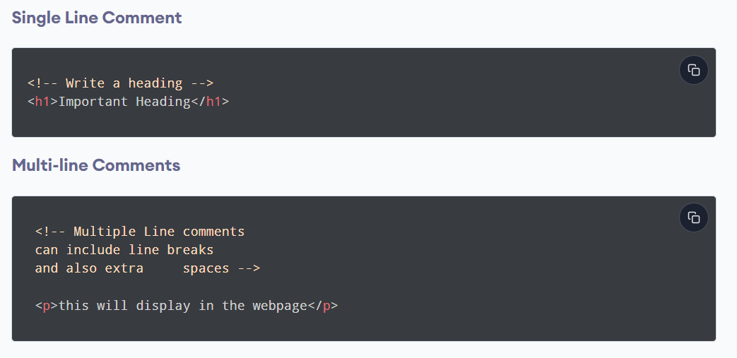
HTML Comments
HTML comments are used to insert notes to a web page.
Notes:
Software Outsourcing Company India - http://www.ifourtechnolab.com/

Slide 13
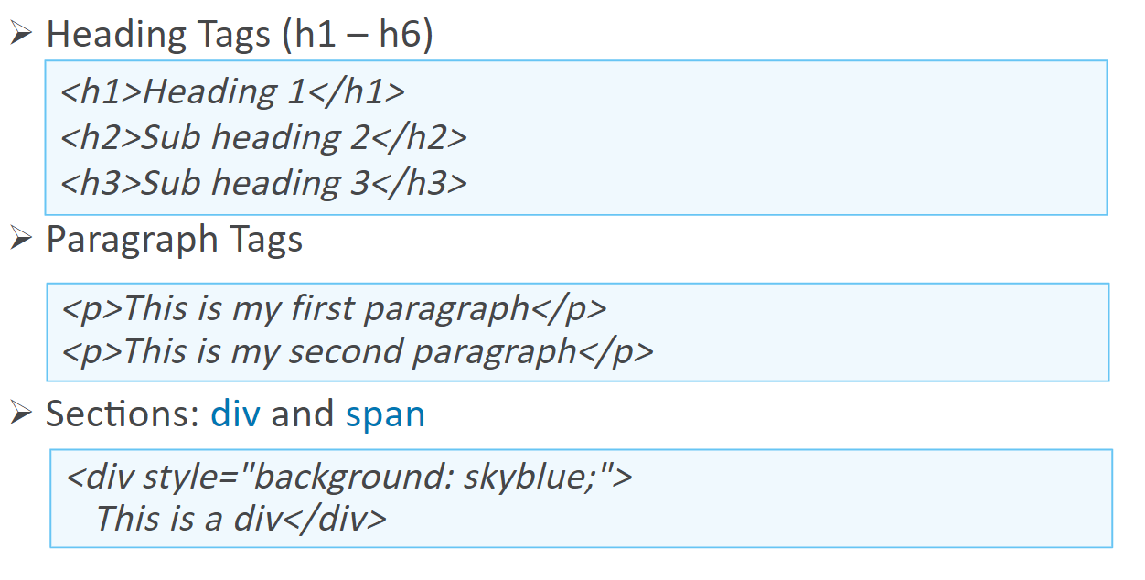
Headings & Paragraphs
Notes:
Software Outsourcing Company India - http://www.ifourtechnolab.com/

Slide 14
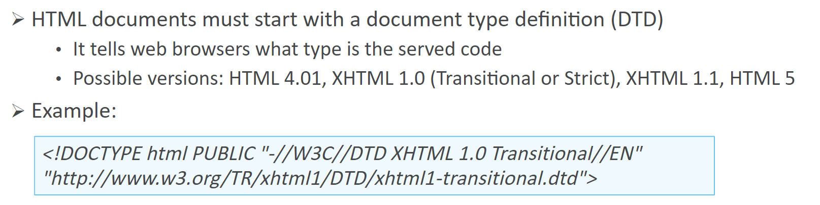
The <!DOCTYPE> Declaration
Notes:
Software Outsourcing Company India - http://www.ifourtechnolab.com/

Slide 15
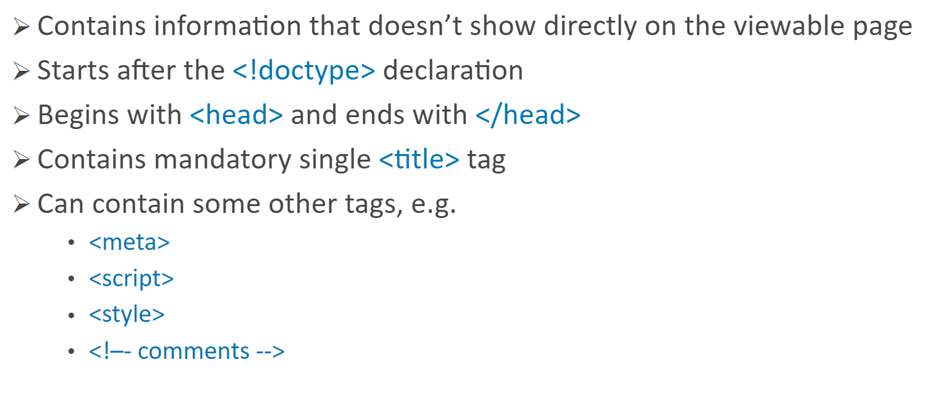
The <head> Section
Notes:
Software Outsourcing Company India - http://www.ifourtechnolab.com/

Slide 16
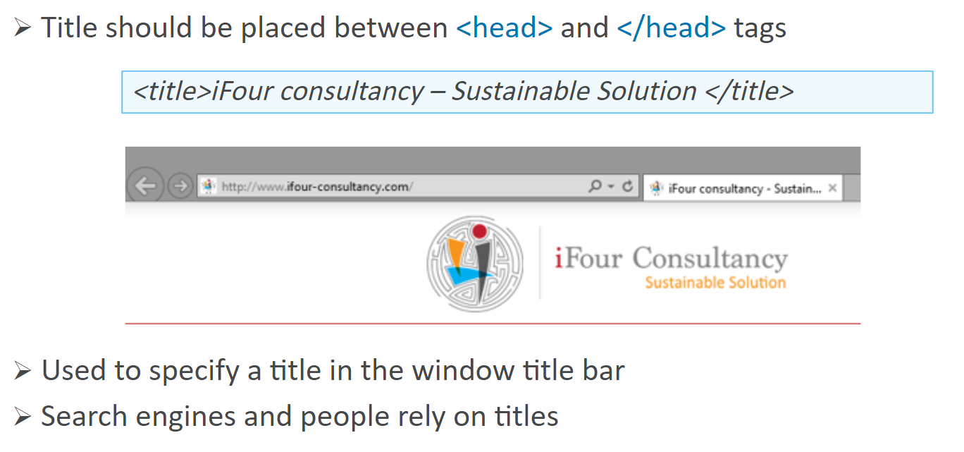
The <head> Section: <title> tag
Notes:
Software Outsourcing Company India - http://www.ifourtechnolab.com/

Slide 17
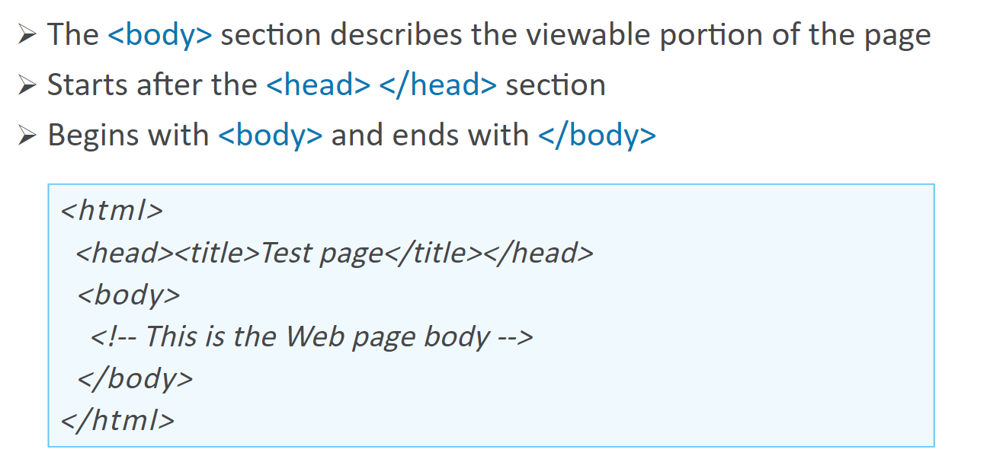
The <body> Section
Notes:
Software Outsourcing Company India - http://www.ifourtechnolab.com/

Slide 18
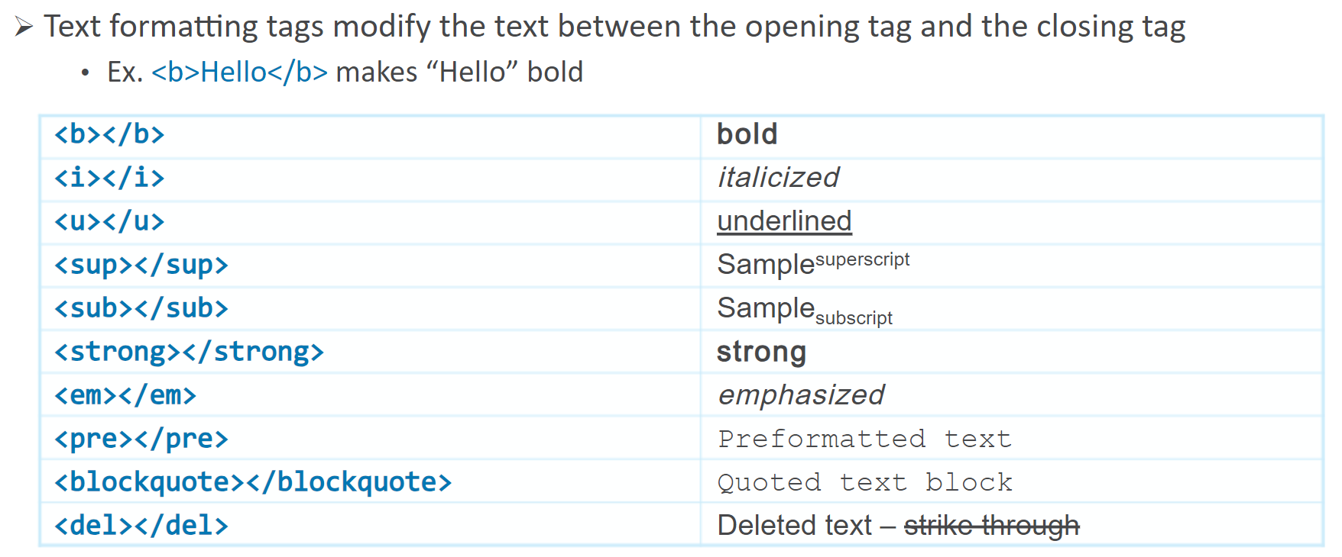
Text Formatting
Notes:
Software Outsourcing Company India - http://www.ifourtechnolab.com/

Slide 19
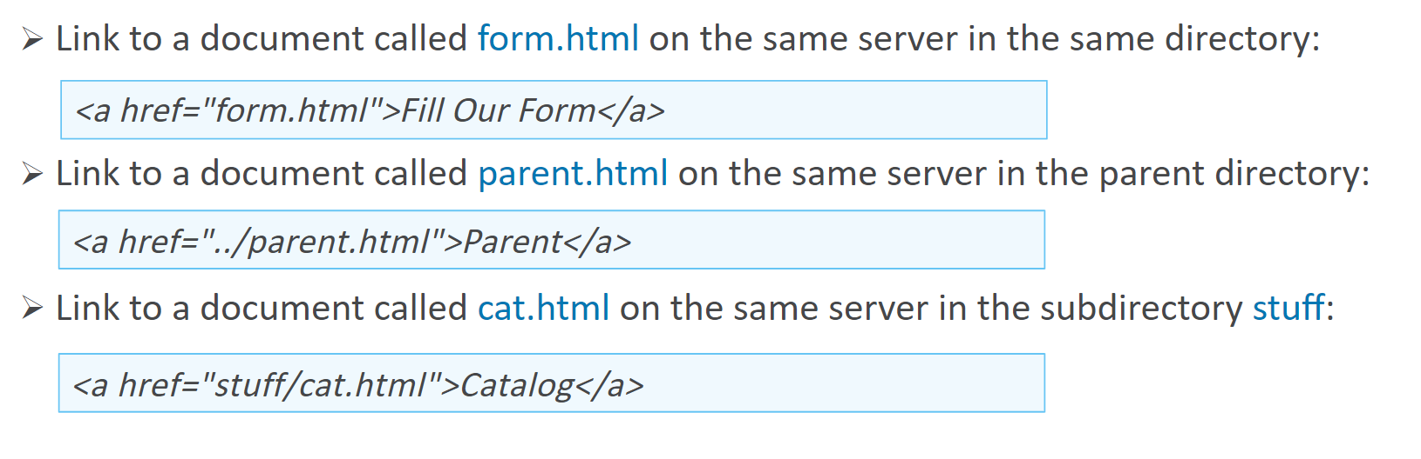
Hyperlinks: <a> Tag
Notes:
Software Outsourcing Company India - http://www.ifourtechnolab.com/

Slide 20
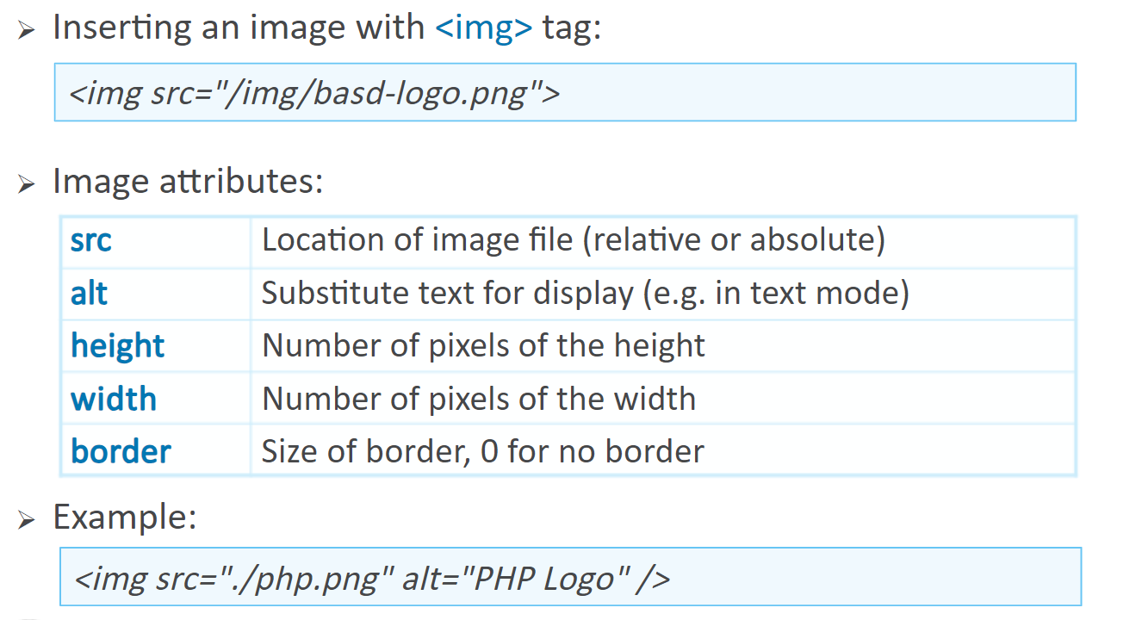
Hyperlinks: <img> Tag
Notes:
Software Outsourcing Company India - http://www.ifourtechnolab.com/

Slide 21
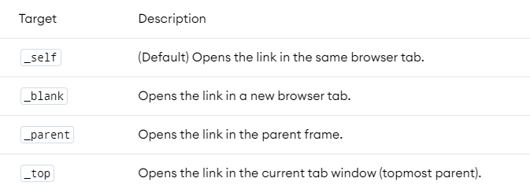
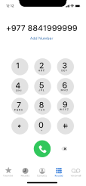
HTML Links – More Attributes
<a href="https://google.com" target="_blank">Google</a>
<a href="/files/logo.png" download> Download Image </a>
<a href="tel:+9778841999999"> Call Us </a>
<a href="mailto:name@domain.com" > Send Mail </a>
Notes:
Software Outsourcing Company India - http://www.ifourtechnolab.com/

Slide 22
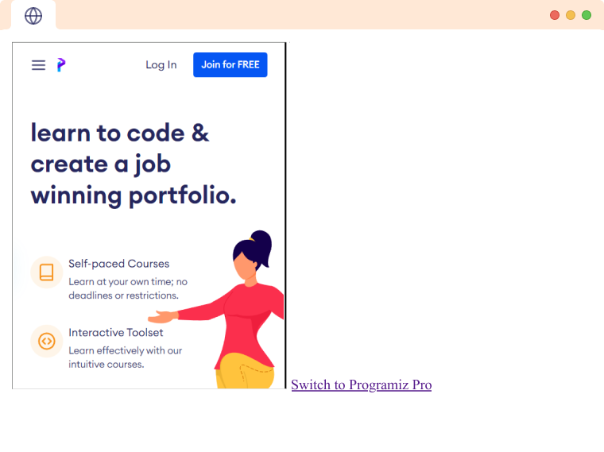
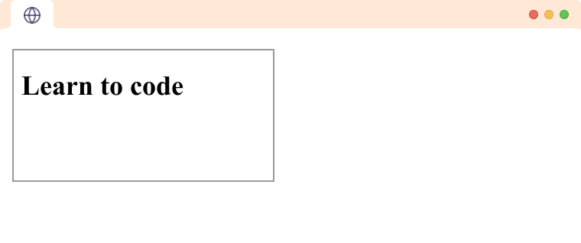
HTML Iframes <iframe>
The HTML <iframe> tag is used to embed a webpage within a webpage. It has core attributes such as height, width, name & srcdoc
<iframe src="https://programiz.pro" title="programiz pro website" height="500" width="500" ></iframe>
Instead of a website URL, we can send HTML directly to the iframe
<iframe srcdoc="<h1>Learn to code</h1>"></iframe>
Notes:
Software Outsourcing Company India - http://www.ifourtechnolab.com/

Slide 23
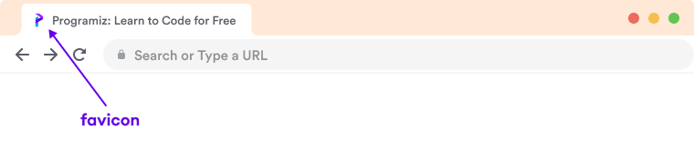
HTML Favicon
A Favicon is a small image displayed on the left of the page title in the browser tab.
<head>
<link rel="shortcut icon" href="favicon.png">
</head>
Notes:
Software Outsourcing Company India - http://www.ifourtechnolab.com/

Slide 24
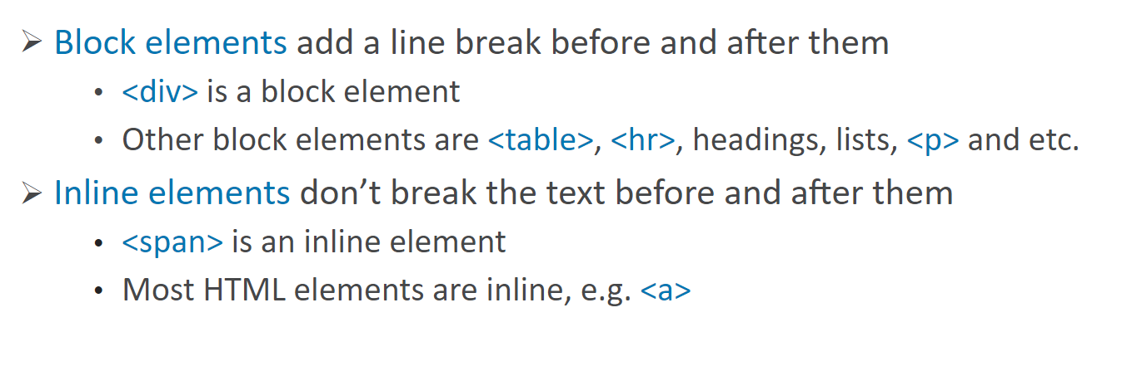
Block and Inline Element
Notes:
Software Outsourcing Company India - http://www.ifourtechnolab.com/

Slide 25
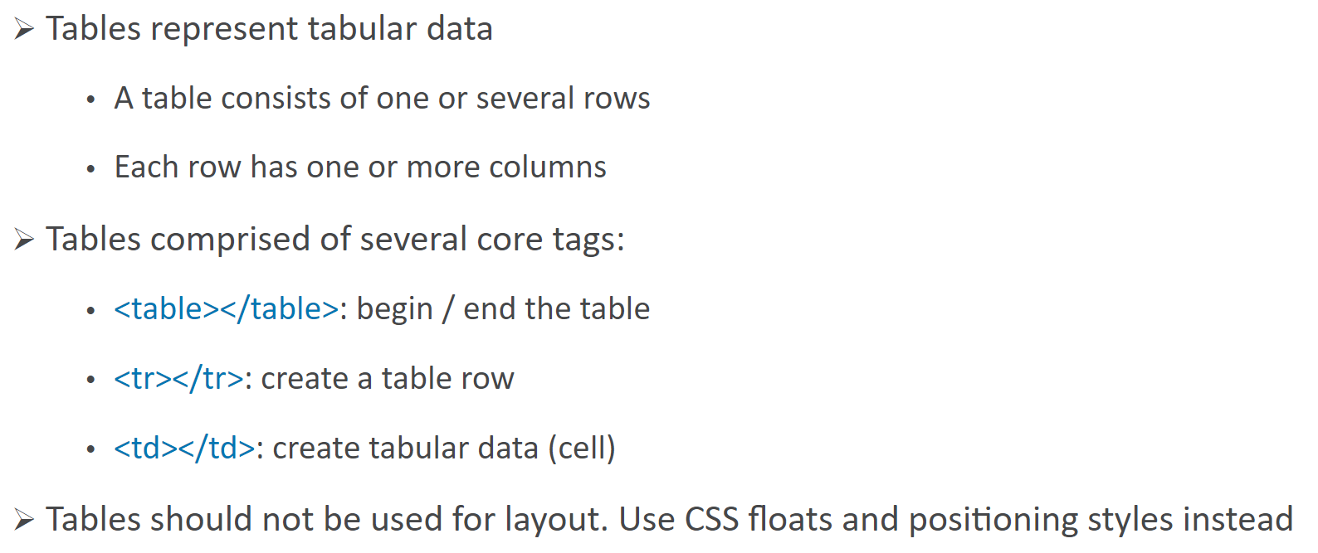
HTML Tables
Notes:
Software Outsourcing Company India - http://www.ifourtechnolab.com/

Slide 26
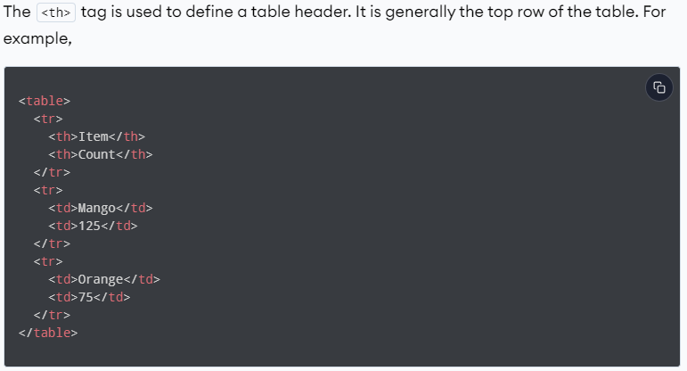
HTML Table Heading, <th>
Notes:
Software Outsourcing Company India - http://www.ifourtechnolab.com/

Slide 27
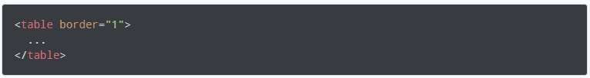
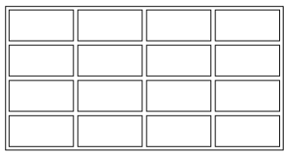
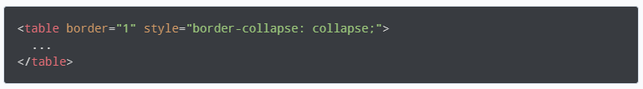
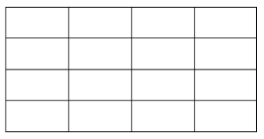
HTML Table Border
the border attribute is used to add a border to a table and all the cells.
To prevent double borders
Notes:
Software Outsourcing Company India - http://www.ifourtechnolab.com/

Slide 28
HTML Table Head, Body, and Footer
We use the <thead> tag to add a table head. Tag must come before any other tags inside a table
We use the <tbody> tag to add a table body. Tag must come after <thead>
We use the <tfooter> tag to add a table footer. Tag must come after <tbody>
<table>
<thead><tr><th>Head1</th></tr></thead>
</table>
<table>
<tbody><tr><td>Head1</td></tr></tbody>
</table>
<table><tfooter><tr><td>footer 1</td></tr></tfooter></table>
Notes:
Software Outsourcing Company India - http://www.ifourtechnolab.com/

Slide 29
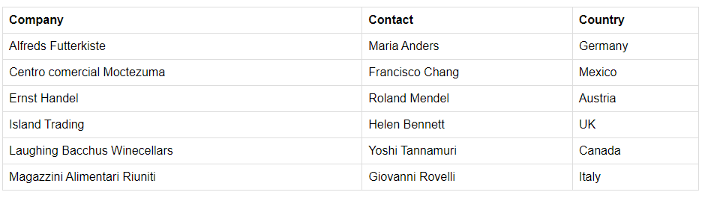
HTML Tables – Practice 01
Write code to make a table bellow
table {font-family: arial, sans-serif;border-collapse: collapse;
width: 100%;}
td, th {border: 1px solid #dddddd;text-align: left;padding: 8px;}
Notes:
Software Outsourcing Company India - http://www.ifourtechnolab.com/

Slide 30
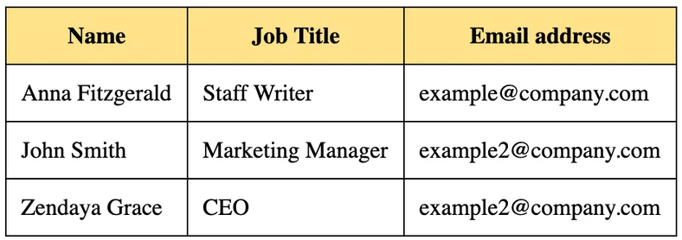
HTML Table - Practice 02
Write code to make a table bellow
Notes:
Software Outsourcing Company India - http://www.ifourtechnolab.com/

Slide 31
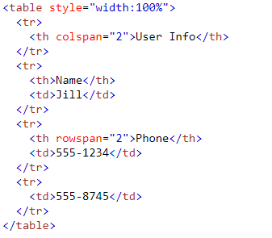
HTML Table rowspan and colspan
The rowspan and colspan are the attributes of <td> tag. These are used to specify the number of rows or columns a cell should merge.
The rowspan attribute is for merging rows columns of the table in HTML.
the colspan attribute is for merging columns of the table in HTML.
Notes:
Software Outsourcing Company India - http://www.ifourtechnolab.com/

Slide 32
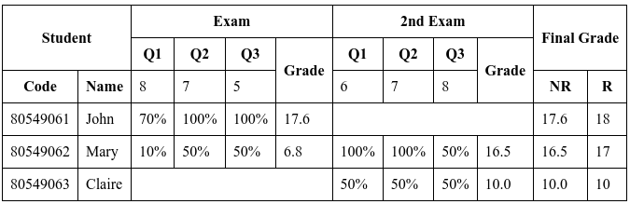
HTML Table – Practice
Write code to make a table bellow
Notes:
Software Outsourcing Company India - http://www.ifourtechnolab.com/

Slide 33
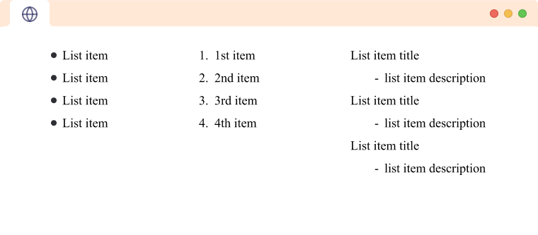
HTML Lists
Used to display related information in an easy-to-read and concise way as lists.
Can use three types of lists
Unordered List <ul>
Ordered List <ol>
Description List <dl>
Notes:
Software Outsourcing Company India - http://www.ifourtechnolab.com/

Slide 34
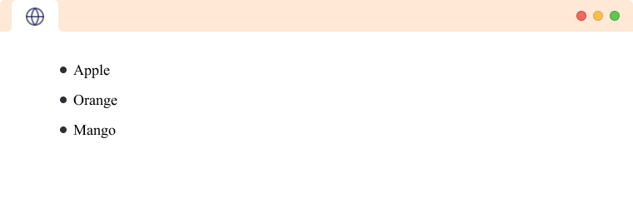
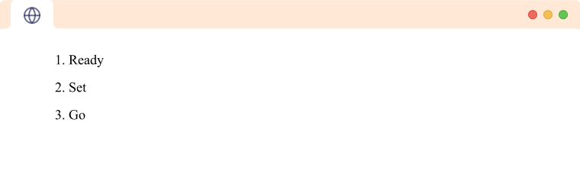
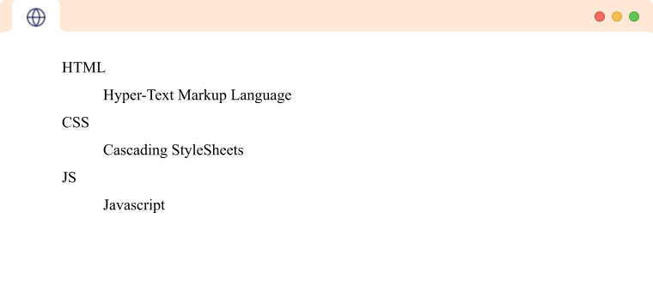
HTML Lists – Ordered, Unordered & Description
Unordered List is used to represent data in a list for which the order of items does not matter.
Ordered List is used to represent data in a list for which the order of items has significance.
Description List is used to represent data in the name-value form.
<ul>
<li>Apple</li>
<li>Orange</li>
</ul>
<ol>
<li>Ready</li>
<li>Set</li>
</ol>
<dl>
<dt>HTML</dt>
<dd>Hyper-Text Markup Language</dd>
</dl>
Notes:
Software Outsourcing Company India - http://www.ifourtechnolab.com/

Slide 35
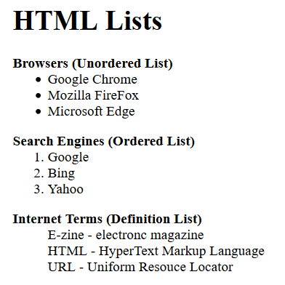
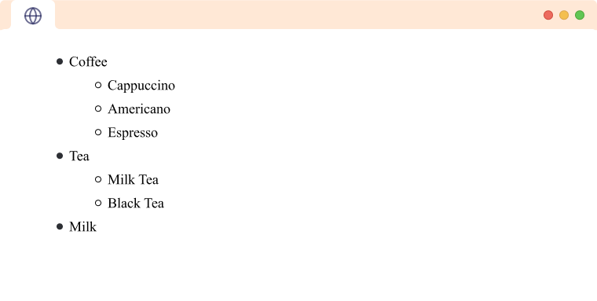
HTML Lists – Practice
Use HTML to make list bellow
Notes:
Software Outsourcing Company India - http://www.ifourtechnolab.com/

Slide 36
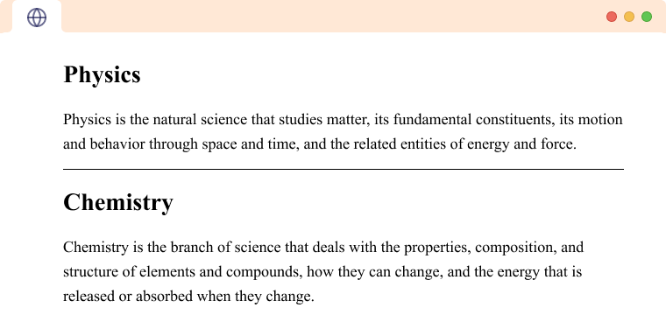
HTML Horizontal Line <hr>
The <hr> is used to insert a horizontal line between our paragraphs
<p>First Paragraph</p>
<hr>
<p>Second Paragraph</p>
Notes:
Software Outsourcing Company India - http://www.ifourtechnolab.com/

Slide 37
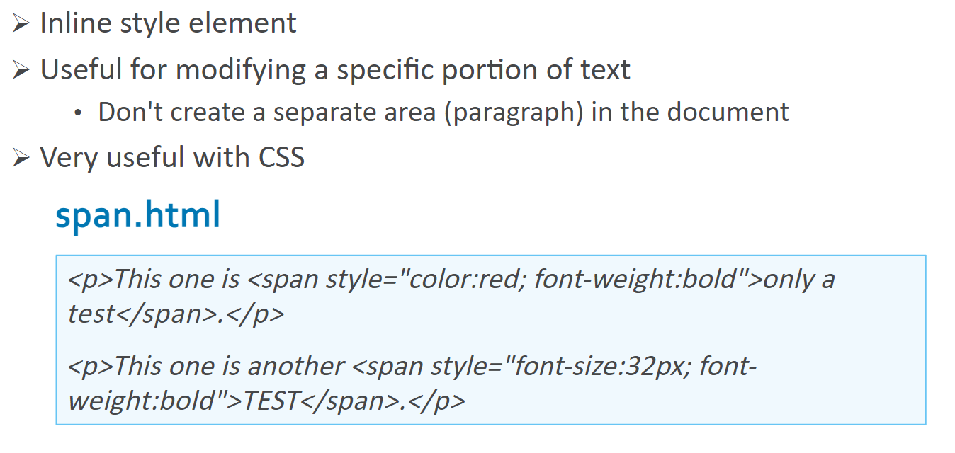
The <span> Tag
Notes:
Software Outsourcing Company India - http://www.ifourtechnolab.com/

Slide 38
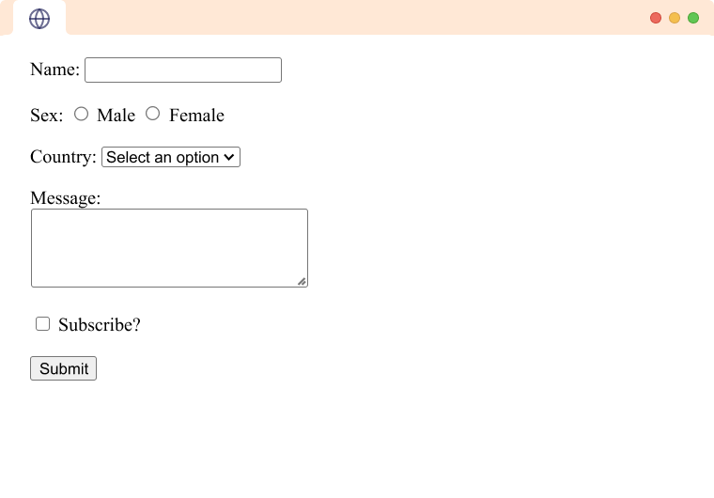
HTML Form <form>
An HTML Form is a section of the document that collects input from the user. It has attribute such as action, name,method,target & id
<form action=“test.html” name=“test”>
-----
</form>
Notes:
Software Outsourcing Company India - http://www.ifourtechnolab.com/

Slide 39
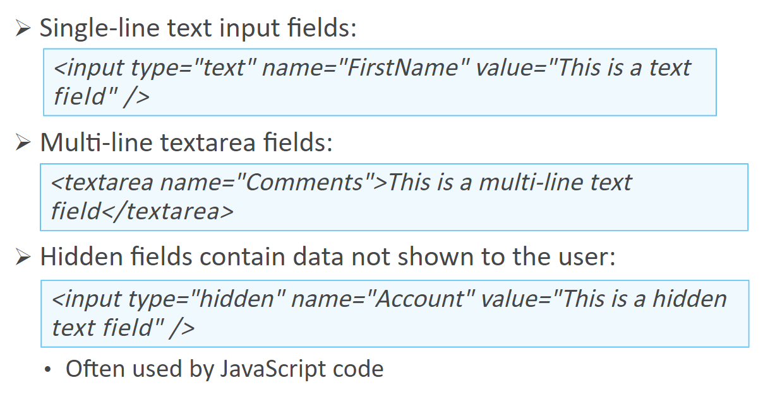
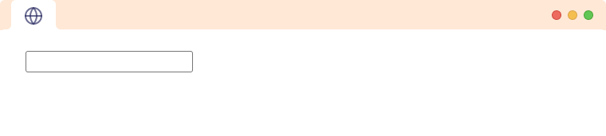
Form Fields – text box, textarea & hidden
Notes:
Software Outsourcing Company India - http://www.ifourtechnolab.com/

Slide 40
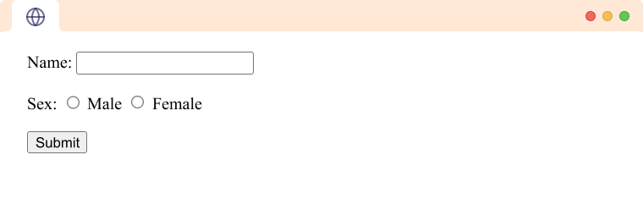
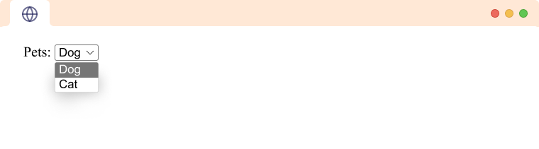
HTML Form - check box, drop-down & submit button
<form>
<label for="name">Name:</label>
<input type="text" name="name"><br><br>
<label for="sex">Sex:</label>
<input type="radio" name="sex" id="male" value="male">
<label for="male">Male</label>
<input type="radio" name="sex" id="female" value="female">
<label for="female">Female</label> <br><br>
<input type="submit" value="Submit">
</form>
<form>
<label for="pets">Pets:</label>
<select id="pets“ name=“pets”>
<option value="dog">Dog</option>
<option value="cat">Cat</option>
</select>
</form>
Notes:
Software Outsourcing Company India - http://www.ifourtechnolab.com/

Slide 41
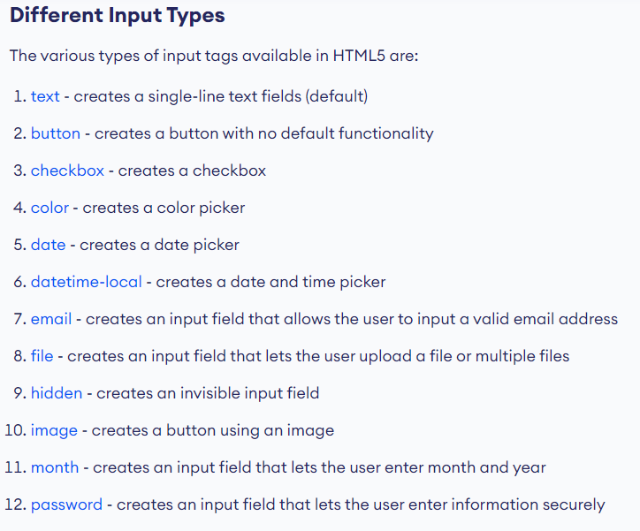
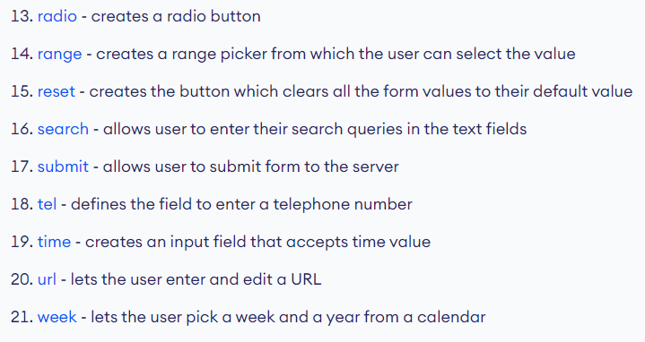
HTML Input Tag
Notes:
Software Outsourcing Company India - http://www.ifourtechnolab.com/

Slide 42
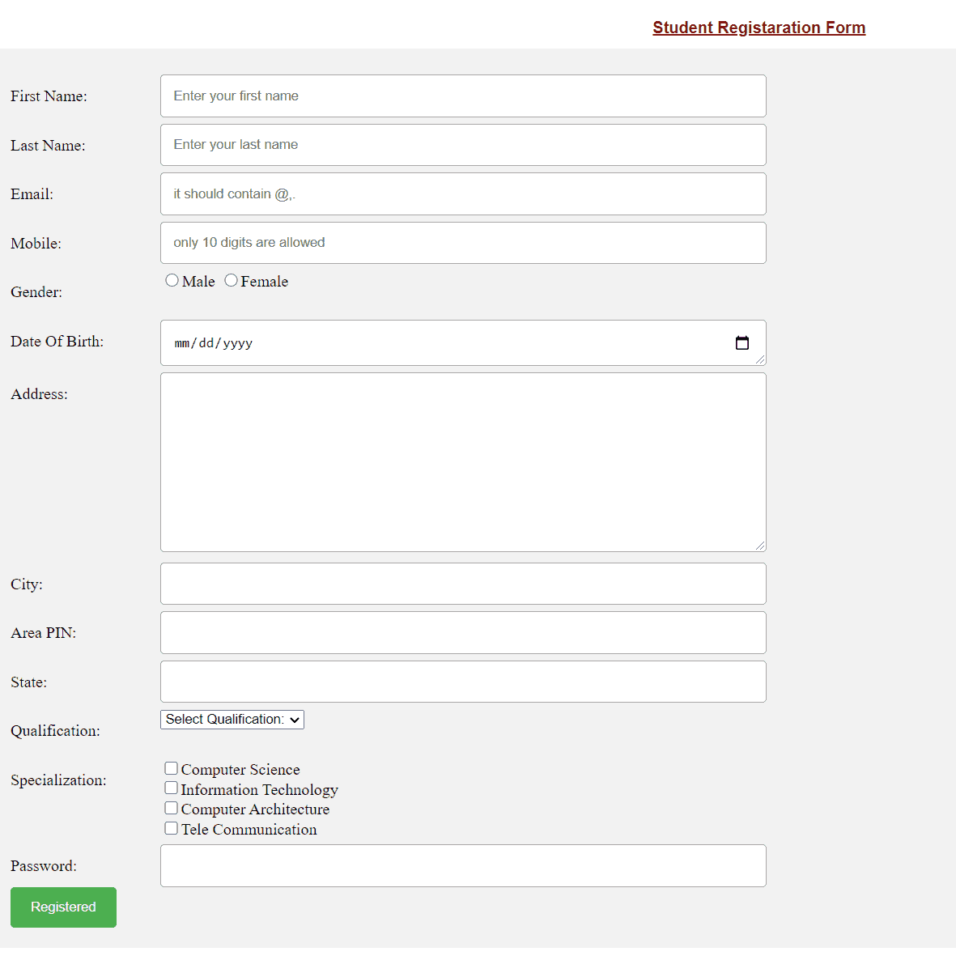
HTML Form - Practice
Write code to make a form bellow
Notes:
Software Outsourcing Company India - http://www.ifourtechnolab.com/

Slide 43
HTML <marquee> Tag
It was used to make the text or image scroll horizontally across or vertically down the web page.
Attributes can be used to adjust the appearance of the <marquee> element.
behavior
scroll
slide
alternate
direction
up
down
left
right
Example:
<marquee>A scrolling text created with HTML Marquee element.</marquee>
<marquee behavior="scroll" direction="up">
<img src=“image.png" width="190" height="45" alt="W3docs" />
</marquee>
Notes:
Software Outsourcing Company India - http://www.ifourtechnolab.com/

Slide 44
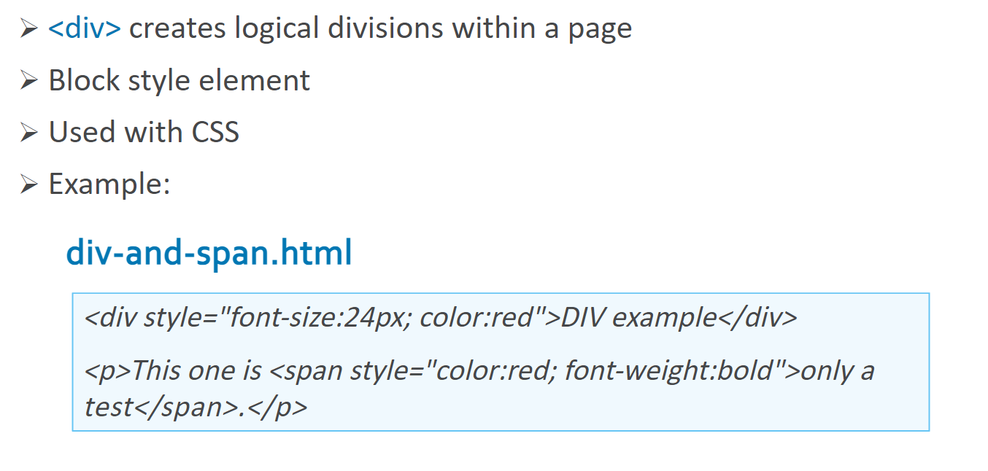
The <div> Tag
Notes:
Software Outsourcing Company India - http://www.ifourtechnolab.com/

Slide 45
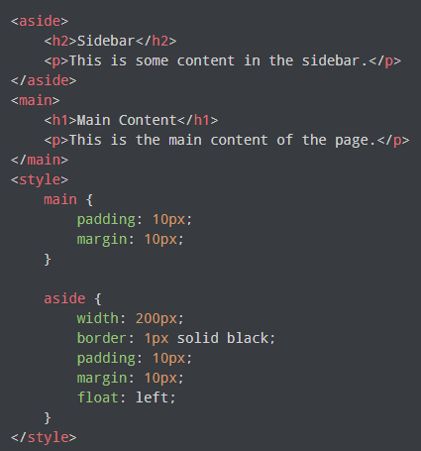
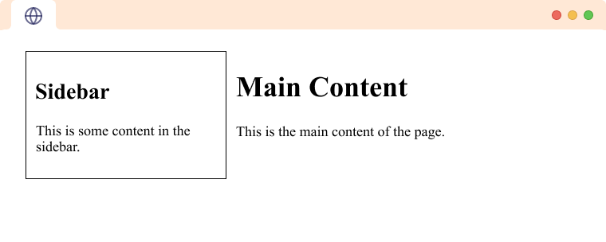
HTML <aside> Tag
The HTML <aside> tag is used to represent a portion of a document that is indirectly related to the main content.
Notes:
Software Outsourcing Company India - http://www.ifourtechnolab.com/

Slide 46
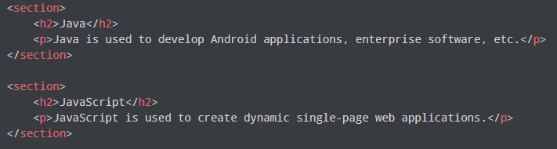
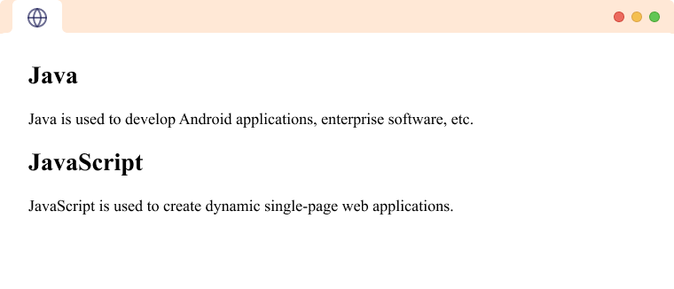
HTML <section> Tag
This tag is used to define a section in the document that generally includes a group of related content.
Notes:
Software Outsourcing Company India - http://www.ifourtechnolab.com/

Slide 47

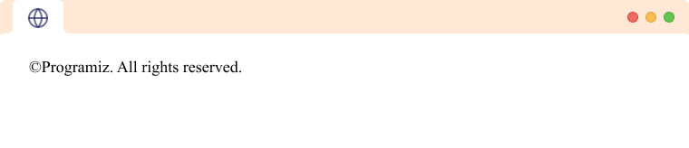

HTML <footer> and <header> Tag
The <header> element represents a container for introductory content or a set of navigational links.
The HTML <footer> tag is used to define the footer of the HTML document or section.
Notes:
Software Outsourcing Company India - http://www.ifourtechnolab.com/

Slide 48
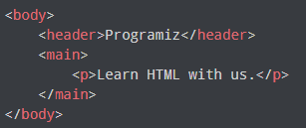
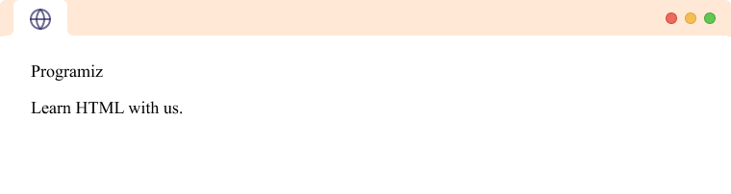
HTML <main> Tag
The HTML <main> tag is used to define the main content of the document.
Notes:
Software Outsourcing Company India - http://www.ifourtechnolab.com/

Slide 49
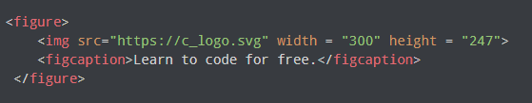

HTML <figure> and <figcaption> Tag
The HTML <figure> tag that represents self-contained graphical content such as illustrations, diagrams, photos, etc.
The HTML <figcaption> tag is used to define the caption for a figure.
Notes:
Software Outsourcing Company India - http://www.ifourtechnolab.com/

Slide 50




HTML Class & ID
An HTML class is an attribute that can be added to an HTML element to give it a specific class name. Note: We use . before classname in CSS.
An HTML id is an attribute that can be added to an HTML element to give it a unique identifier. Note: We use # before id in CSS.
Notes:
Software Outsourcing Company India - http://www.ifourtechnolab.com/

Slide 51


HTML Layout
HTML layout refers to the way in which the content of a website is organized and structured.
Notes:
Software Outsourcing Company India - http://www.ifourtechnolab.com/

Slide 52

HTML Layout – Practice
Write code to make layout bellow
Notes:
Software Outsourcing Company India - http://www.ifourtechnolab.com/

Slide 53


HTML Responsive Web Design
Responsive web design is a web design approach to make web pages render well on all devices with different screen sizes and viewports.
There are many ways to make a webpage responsive:
Viewport meta tag
Responsive typography
Responsive images
Media Queries
Responsive layout technologies
Responsive
Notes:
Software Outsourcing Company India - http://www.ifourtechnolab.com/

Slide 54



HTML Responsive Web Design - More
We can add viewport in the <meta> tag to make the webpage responsive.
width=device-width - width of the webpage is equal to the width of the device
initial-scale=1.0 - zoom level of 100%.
Responsive Text
Media query is a CSS technique that defines completely different styles for different browser sizes.
Responsive Images
Browser Output (screensize < 600)
Notes:
Software Outsourcing Company India - http://www.ifourtechnolab.com/

Slide 55


HTML Video
The HTML <video> tag is used to embed a media player which supports video playback into the HTML page.
Let us look at the attributes supported by the HTML <video> tag.
autoplay
Controls
Height & width
Loop
Muted
Src
preload
Notes:
Software Outsourcing Company India - http://www.ifourtechnolab.com/

Slide 56


HTML Audio
The HTML <audio> tag is used to embed a media player which supports audio playback into the HTML page.
Let us look at the attributes supported by the HTML <video> tag.
autoplay
Controls
Loop
Muted
Src
preload
Notes:
Software Outsourcing Company India - http://www.ifourtechnolab.com/

Slide 57



HTML Emojis
Emoji are small graphical images that are used to represent emotions, objects, and ideas.
Notes:
Software Outsourcing Company India - http://www.ifourtechnolab.com/

Slide 58
Thank You…
Notes:
Software Outsourcing Company India - http://www.ifourtechnolab.com/

